Slide 1
Module 2 Multidimensional data representation and manipulation
Lesson 6: Overview of WebPivotTable
Notes:
Welcome to Lesson 6 of Module 6 on Multidimensional data representation and manipulation
What feature is in WebPivotTable but not in Pivot4J?
Does WebPivotTable support MDX?

Slide 2
Lesson Objectives
Gain exposure to WebPivotTable
Learn about alternative to pivot tables in Microsoft Excel
Notes:
Previous video lecture introduced Pivot4J
This lectures covers WebPivotTable, another convenient interface to manipulate data cubes.

Slide 3
WebPivotTable
Web-based for desktop and mobile devices
Execute independently or integrate into web sites
Javascript implementation
Mimics features in Microsoft Excel pivot tables
Flexible usage, interfaces, and output formats as well as MDX support
Notes:
Web based tool for pivot tables with functionality similar to Excel pivot tables
http://webpivottable.com/
It is free and needs no installation.
Only requirement is a browser.
Save to Excel or CSV files
Save, reopen, and share
Support to connect to Microsoft Analysis Service, Pentaho Mondrian, icCube and other OLAP engines.
Guided practice

Slide 4
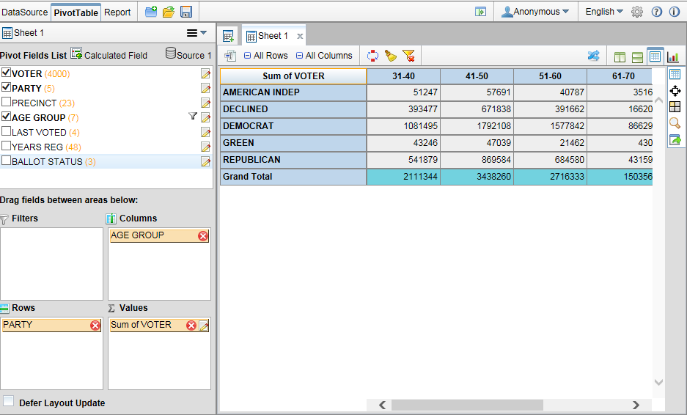
Basic Pivot Table
Notes:
Field list on left
Party on the rows
Age group on the columns
Voter count measure summed in cell

Slide 5
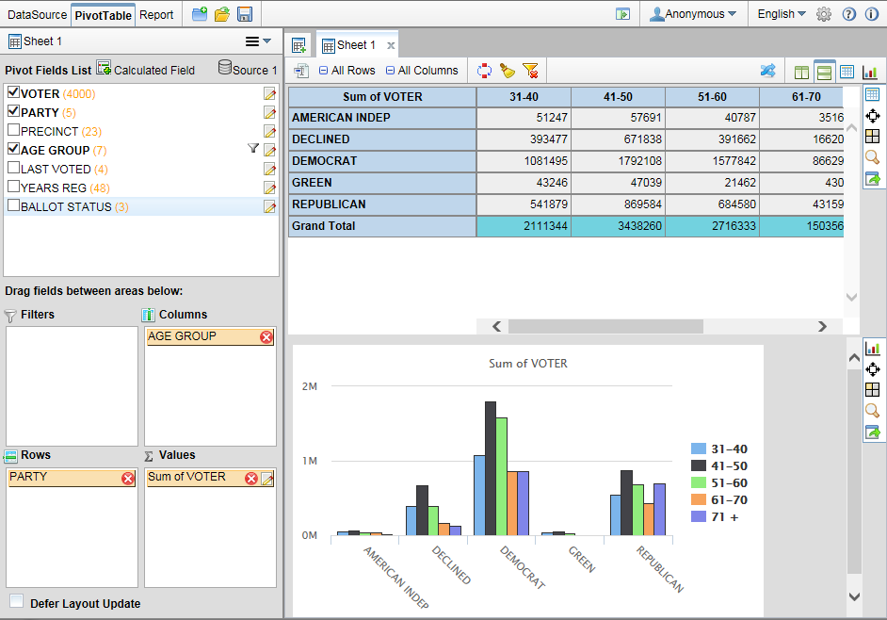
Pivot Table with Chart
Notes:
Chart generated by

Slide 6
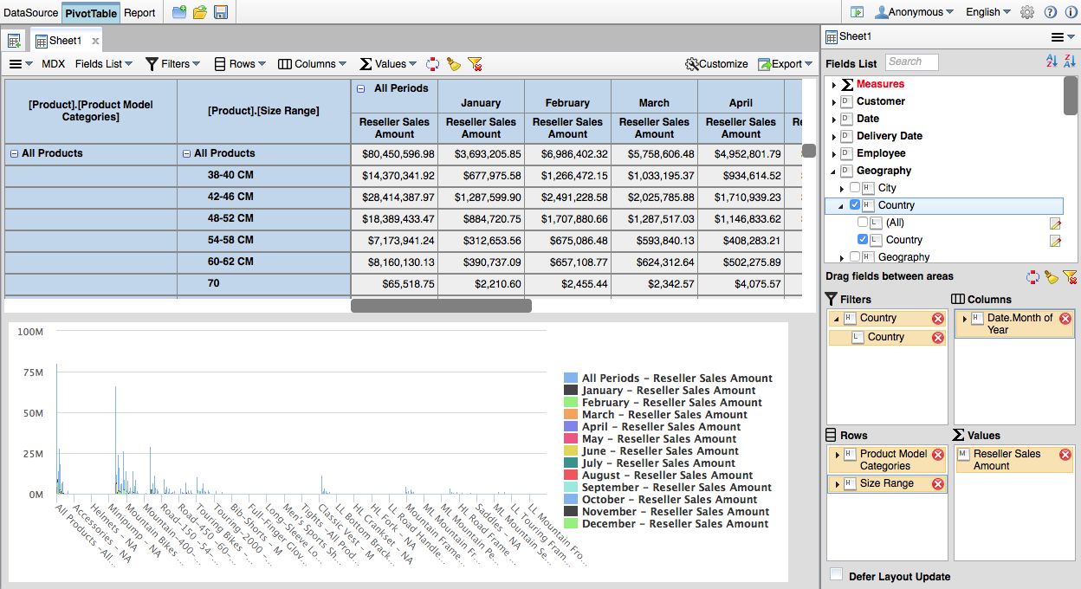
External OLAP Server Usage
Notes:
When using an OLAP data cube, WebPivotTable acts as a client connected to an OLAP server. With cube calculations performed on an external OLAP server, slow performance or server errors can occur for complex operations on a pivot table.
This snapshot depicts the Microsoft AdventureWorks cube with 16 dimensions with 47 measures as shown in the Fields List pane. The pivot table in the snapshot contains Size Range and Product Model Categories on the Rows area, Date Month of Year on the Columns area, and Reseller Sales Amount measure in the Values area. The filter on Country acts as a slicer restricting calculations to selected countries. The MDX button displays the MDX SELECT statement to generate the pivot table.

Slide 7
Summary
Features similar to Microsoft Excel Pivot Tables
Supports external OLAP servers and MDX
Convenient browser usage
Notes:
Pivot4J
Extension of Jpivot project
Visual interface for MDX
Part of Pentaho Business Analytics open source software
Guided practice and assignment
WebPivotTable
Excel pivot tables
Only need browser

